Slide 1
Sales Dashboard
Project

Slide 2
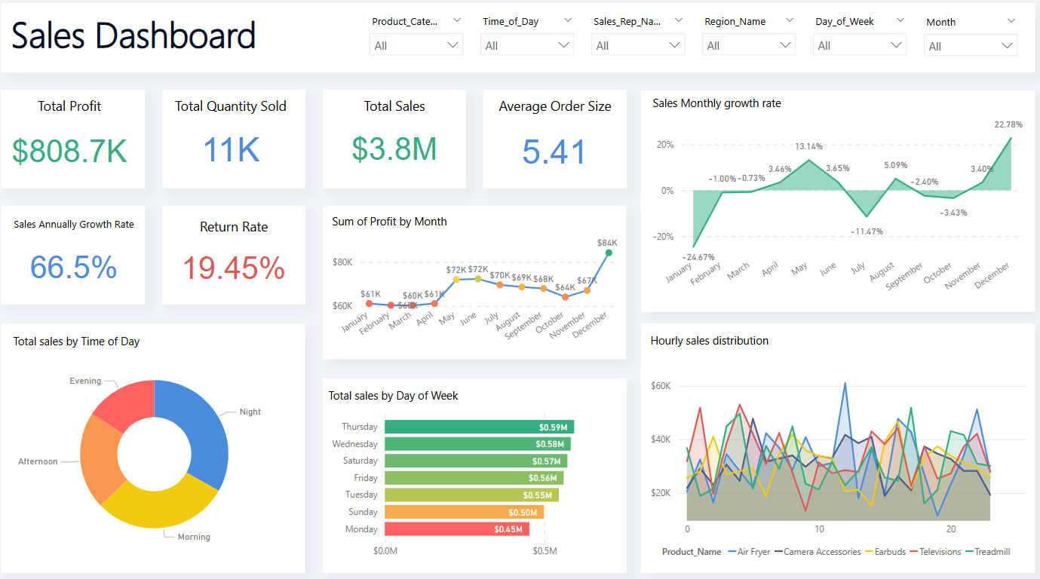

Slide 3
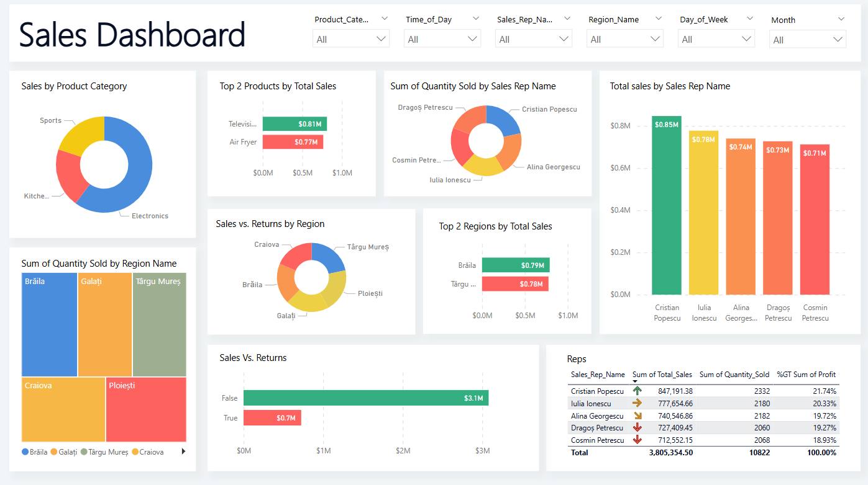

Slide 4
Actionable Insights (Data Observations):
The best-performing products are "Televisions" and "Air Fryer." ➔ Electronics are clearly outperforming other categories in total sales.
The peak sales periods are during "Evening" and "Night." ➔ Based on the Time-of-Day analysis, sales significantly increase after the afternoon hours.
The strongest sales days are Thursday and Wednesday. ➔ The bar chart for sales by day of the week shows that Thursday has the highest sales, followed by Wednesday.
Recommendations (For Sales Improvement):
Increase marketing campaigns during evening and night hours. ➔ Since peak sales happen during these periods, focusing advertising and promotional efforts between 5 PM and 11 PM could drive even more sales.
Expand and promote the Electronics product category (especially televisions). ➔ Launching special offers and targeted campaigns for electronics, particularly televisions, could significantly boost revenue given their current strong performance.

Slide 5
Thank you

